Slide 1


Slide 2
Routes to High Profits, economies of Scale and Learning
B189

Slide 3
Agenda
Creating value
Reducing Costs
Does quality cost money?
Experience, scale and learning

Slide 4
The story so far…
Why is a firm making money?
  It’s the industry (Porter 5 forces external analysis)
    Implications for managers
      Signaling strategies, tacit collusion, differentiation, brand, market segmentation, innovation, demand (re-)creation
  It’s the firm
    Implications for managers
      Create competencies that are valuable, rare, non-substitutable and inimitable…

Slide 5
Creating value
Creating value
Reducing cost
Quality and cost
Scale and
Learning
Higher value
Do the things customers
want better
V
Do more things
customers want
P
Quality
Innovation
?
C
Lower
costs

Slide 6
Creating Value
Creating value
Reducing cost
Quality and cost
Scale and
Learning
Manufacturing/Production
  Raise quality -> increase in value
Sales and Marketing
  Market segmentation
  Tailor new product to segment needs
Customer Service
  The product’s success (and the company reputation) depend on quality of the support as well as that of the product
HR
  Training
    E.g. Call center staff
IT
  CAD/CAM
    Increase product variety
    Better able to meet specific segment needs
  Customer support
    Customer relationship management software
Notes:
Customer service
Buying beef in Steyning
Inn on the park - name recognition
Reliability
Lee Iacoa / chrysler and jro
Customer support
C = T/q = (F + cq)/q = F/q+c
Learning – more opportunities to get it wong so improvement is easier, at least at first.
Japanese companies and strategic pricing for market share (volume)
Myopia at TI – experience require not changing but new technologies imply change.

Slide 7
Creating Value
Creating value
Reducing cost
Quality and cost
Scale and
Learning
Sales and Marketing (and R&D)
  Create products for high margin segments
  Raise awareness and build brand (advertising)
  Innovate (R&D)
  Raise commission and salaries
Features
3
2
Higher Value
Quality
1
1
2
3
Notes:
Customer service
Buying beef in Steyning
Inn on the park - name recognition
Reliability
Lee Iacoa / chrysler and jro
Customer support
C = T/q = (F + cq)/q = F/q+c
Learning – more opportunities to get it wong so improvement is easier, at least at first.
Japanese companies and strategic pricing for market share (volume)
Myopia at TI – experience require not changing but new technologies imply change.

Slide 8
Reducing costs
Creating value
Reducing cost
Quality and cost
Scale and
Learning
Higher value
V
Quality
Innovation
P
C
Design better production
processes
Reduce waste
Lower
costs

Slide 9
Reducing costs
Creating value
Reducing cost
Quality and cost
Scale and
Learning
Manufacturing/Production
  Economies of scale
    Spreading of fixed costs
    Specialization
  Learning effects
    More applicable to complex operations
Purchasing
  JIT (less inventory)
  Supplier relationships
Marketing
  Reputation, word of mouth
  Penetration
  Defection rates
HR
  Training
  Self managing teams
  Incentives
IT
  EDI
    JIT, data entry
  Customer support
    (e.g. FAQs, expert systems for problem diagnostics
    Call center management
Notes:
C = T/q = (F + cq)/q = F/q+c
Learning – more opportunities to get it wong so improvement is easier, at least at first.
Japanese companies and strategic pricing for market share (volume)
Myopia at TI – experience require not changing but new technologies imply change.

Slide 10
Reducing costs
Creating value
Reducing cost
Quality and cost
Scale and
Learning
Optimize production
  Overtime (x1.5)
  Second shift (x1.1)
  Inventory stockpiling
Train production employees
Consider off-shoring production
Plan ahead
  layoffs are costly
Notes:
C = T/q = (F + cq)/q = F/q+c
Learning – more opportunities to get it wong so improvement is easier, at least at first.
Japanese companies and strategic pricing for market share (volume)
Myopia at TI – experience require not changing but new technologies imply change.

Slide 11




Does quality cost money?
Creating value
Reducing cost
Quality and cost
Scale and
Learning
Too wide,
reject.
Perfect,
pass.
Too thin,
pass. But…
Scrap – or rework
Reliability problems,
weak and failure
Notes:
Section 7 to here

Slide 12
Six sigma (σ) quality
Creating value
Reducing cost
Quality and cost
Scale and
Learning
~ four σ quality
~ one σ quality
Part too small
Part too large

Slide 13
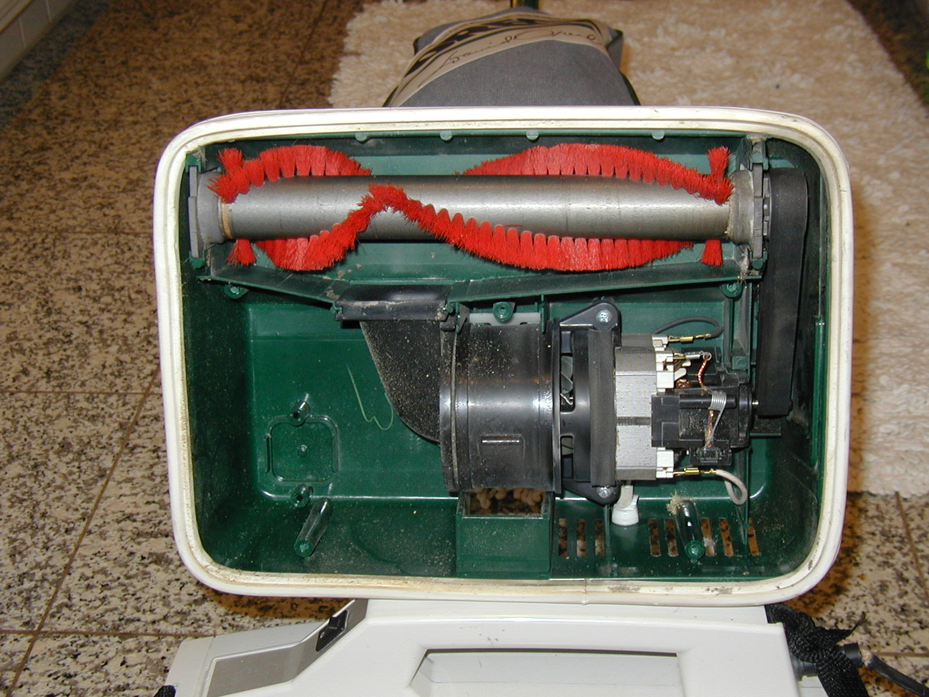
Inside an Oreck vacuum cleaner
Creating value
Reducing cost
Quality and cost
Scale and
Learning

Slide 14
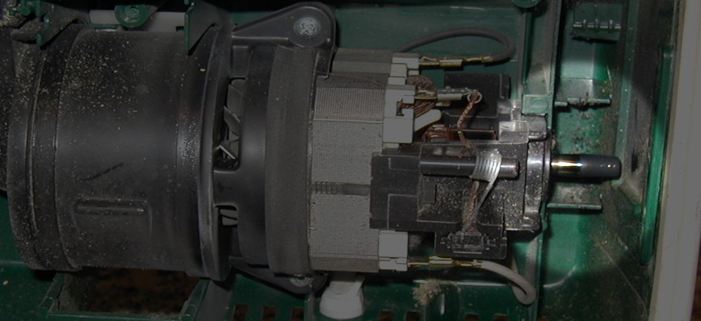
Inside an Oreck vacuum cleaner
Creating value
Reducing cost
Quality and cost
Scale and
Learning

Slide 15
Reducing cost through quality
Creating value
Reducing cost
Quality and cost
Scale and
Learning
  Total Quality Management
    Product and service
  Six sigma or Kanban / lean manufacturing
    Less re-work
    Fewer product defects / recalls
  Measurement (sampling)
  Incentives
  Teams
  Supplier relationships (get higher quality inputs)
  Design for manufacturability (or service delivery)

Slide 16
Summary
Creating value
Reducing cost
Quality and cost
Scale and
Learning
Quality may seem to increase cost locally / in the short run
Holistically and in the long run saves money
  Less waste
  Lower after-sales costs

Slide 17
The Experience Curve
Creating value
Reducing cost
Quality and cost
Scale and
Learning
Studies during WWII demonstrated a relationship between the number of ships produced and the cost of building each ship…

Slide 18
The Experience Curve
Creating value
Reducing cost
Quality and cost
Scale and
Learning
The relationship between the number of ships produced and the cost of production became known as “the experience curve”
This can be divided into two components
  Economies of Scale
  Learning Effects

Slide 19
Economies of Scale
Creating value
Reducing cost
Quality and cost
Scale and
Learning
Defraying fixed costs
Greater specialization
Unit
cost
c₀
c₁
v₀
v₁
Annual production volume

Slide 20
Learning
Creating value
Reducing cost
Quality and cost
Scale and
Learning
Unit
cost
c₀
c₁
c₂
v₀ ,v₂
v₁
Annual production volume

Slide 21
Summary
The “Experience Curve” is made up of economies of scale and learning effects
Economies of scale anyone can achieve
Competitors may struggle to match your cumulative volume even if they can get the same market share
Learning is an important source of first mover advantage
Knowledge is often ‘sticky’ and leaning is hard to replicate / imitate

Slide 22


